Slide 1
FILE HANDLING IN JAVA
P TEJASWINI REDDY

Slide 2
INTRODUCTION
File Handling is an integral part of any programming language as file handling enables us to store the output of any particular program in a file and allows to perform certain operations on it.
File handling in Java is defined for reading and writing data from and to a file. The particular file class from the package called java.io allows us to handle and work with different formats of files easily. Whenever we want to use a file class, we need to create an object of that particular file class and should specify the filename or directory name to it.

Slide 3

Introduction
File handling in Java is defined for reading and writing data from and to a file. The particular file class from the package named as java.io allows us to work with different formats of files. Thus, if we want to use a file class, we need to create an object of that particular class and should specify the filename or by specifying the directory name.

Slide 4
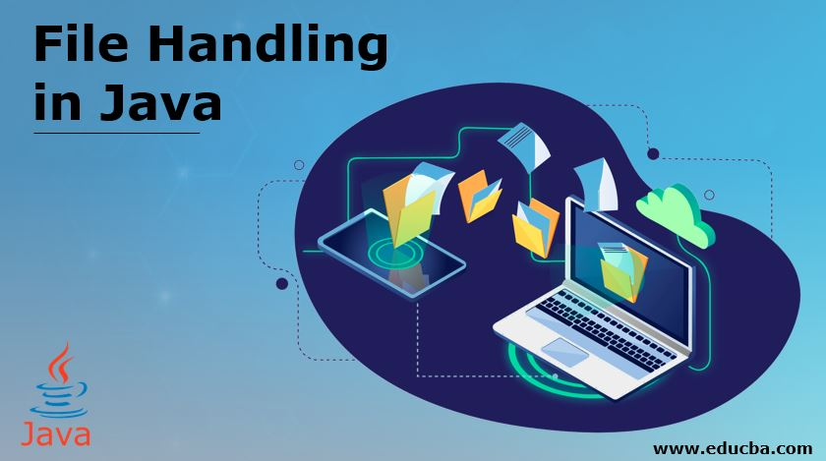
Mastering File Handling in Java
File handling is a crucial part of any Java application. In this presentation, we will explore best practices and advanced techniques to help you become a master of file handling in Java.

Slide 5
Why File Handling in Java?
File handling is a crucial of many Java applications. It allows us to interact with ﬁles on the ﬁle system, enabling data persistence and manipulation of data. Understanding ﬁle handling is fundamental for developers working on projects that involve reading or writing ﬁles data, such as data processing, log analysis, or ﬁle-based databases,etc.

Slide 6
Basic File Operation
To carryout various basic ﬁle operations in Java, we use classes from the java.io package. These classes provide methods to create, read, write, and delete ﬁles(operations on file). We need to understand the Files, FileWriter, FileReader, and FileInput Stream classes, along with their respective methods, to know how to manipulate ﬁles at a basic level of programming.

Slide 7
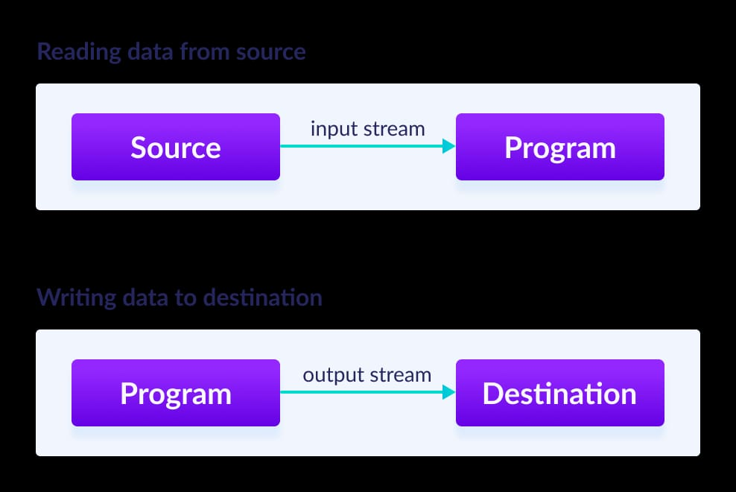
Streams in java
In Java, a sequence of data is known as a stream.
This concept is used to perform I/O operations on a file.
There are two types of streams :
Input Stream
Output Stream

Slide 8
Input Streams
The Java InputStream class is the superclass of all input streams. The input stream is perform reading operations to read data from numerous input devices like the keyboard, mouse ,network, etc. InputStream is an abstract class, and because of this, it is not useful by itself cause its subclasses also are used to read data.

Slide 9
Input Streams Types
AudioInputStream
ByteArrayInputStream
FileInputStream
FilterInputStream
StringBufferInputStream
ObjectInputStream

Slide 10
Output Streams
The output stream is used to perform write operations by writing data to numerous output devices like the monitor, screen,file, etc. OutputStream is an abstract superclass that represents an output stream. OutputStream is an abstract class and because of this, it is not useful by itself cause its subclasses are also used to write data.

Slide 11
Output Streams Types
ByteArrayOutputStream
FileOutputStream
StringBufferOutputStream
ObjectOutputStream
DataOutputStream
PrintStream

Slide 12
Using Buffered Streams for Improved Performance
Working with large files can be slow and inefficient without buffered stream. Buffered streams can help improve performance by reducing the number of I/O operations. We'll discuss how to use BufferedInputStream and BufferedOutputStream to improve file handling performance.

Slide 13
Using Java 8's Stream API for File Operations
Java 8 introduced the Stream API, which provides a concise and powerful way to perform operations on collections. We'll explore how to use Streams for file operations such as filtering, sorting, and mapping.

Slide 14
Using Java's Serialization API
Java's Serialization API provides a way to convert Java objects to a binary format for storage or transmission. API is used for object serialization and deserialization.

Slide 15
Managing File Resources with try-with-resources
When working with files, it's crucial to properly manage resources to prevent resource leaks and ensure that files are properly closed. We can learn how to use try-with-resources to automatically manage file resources.

Slide 16
Working with Compressed Files
Compressed files are a common way to reduce file size and improve transfer speeds. We can use techniques for reading and writing compressed files using Java's GZIP and ZIP APIs.

Slide 17
Working with File Metadata
Files often have associated metadata such as creation date, last modified date, and file size. We can use techniques for reading and setting file metadata using Java's File and Path APIs. File metadata and file properties are information that tells or relate to a file, such as its name, size, type, date, author, location, and tags.

Slide 18
Using Java's Watch Service for File Monitoring
Java's Watch Service provides a way to monitor file and directory changes in real-time. We can use this API for file monitoring and directory monitoring. We have to create a new WatchService by using the newWatchService() method of FileSystem class.

Slide 19

Best Practices for File Handling in Java
Best practices for file handling in Java areerror handling, resource management, and performance optimization.

Slide 20
Common File Handling Mistakes to Avoid
Even senior Java developers make mistakes when handling files. Some common file handling mistakes to avoid, such as leaving files open, not handling exceptions, and not properly managing resources.

Slide 21
Advantages of file handling
We've covered a lot of ground in this presentation, but file handling is a vast topic. Here are some advanced techniques to explore further, including encryption and decryption, file compression, and network file transfers.

Slide 22

.
CONCLUSION
File handling is a critical part of Java development, and mastering it requires both knowledge and practice. I hope this presentation has valuable insights and techniques to understand a file handler in Java betterly.

Slide 23


Contact me:
9108090789
tejaswinireddypedarapu@gmail.com
Thank You

